Slide 1


Exploring the Impact of Interest Rate Changes on the Australian Housing Market: Insights from Interactive Data Visualizations
Group 4 – Anshuman Panigrahi, Robert Franklin, Zalak Shah
January 2023

Slide 2
Table of contents
01 | Introduction | 3
02 | Our Approach | 5
03 | Our Interactive Dashboard | 7
04 | Limitations & Future Work | 12
05 | Q&A! | 14

Slide 3
Introduction
01

Slide 4
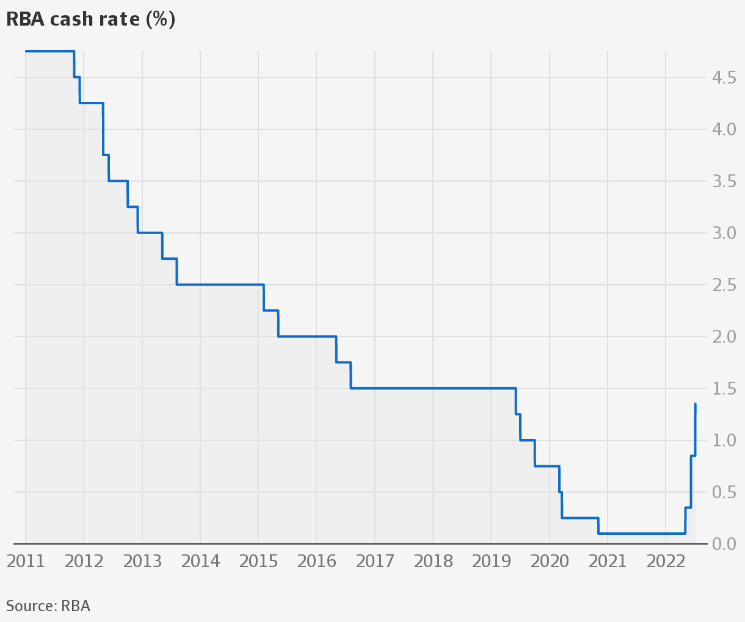
Introduction: InteractiveDataViz
Brief overview of the project
Purpose of the project
Importance of understanding the relationship between interest rate changes and the Australian housing market
Notes:
Inspiration for this project came from the need to understand the likely impacts of recent accelerated interest rate changes on the Australian housing market. Explain how the project is a unique contribution to the field of economic analysis and market trends.

Slide 5
Our Approach
02

Slide 6
Approach
01
Identify data sources
02
ETL
03
Web Framework
04
Data Visualisation
03
ABS & RBA
Recent data only
Extraction: API & Web scraping
Transform: Python (Jupyter Notebooks)
Load: SQL, SQLAlchemy, Postgres, Amazon
HTML: Bootstrap navbar, grid system
CSS
Python Flask app
Javascript (Plotly, Jquery, D3, Leaflet)
Notes:
Flask app: serve dynamic content to the user's browser

Slide 7
Our Interactive Dashboard
03

Slide 8
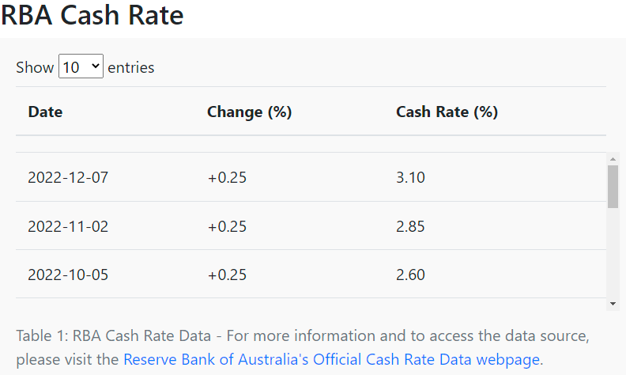
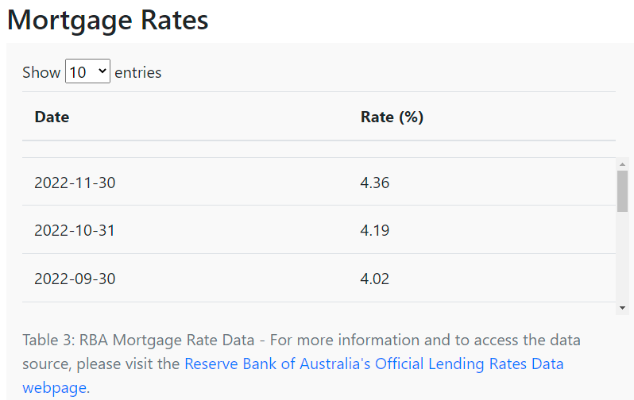
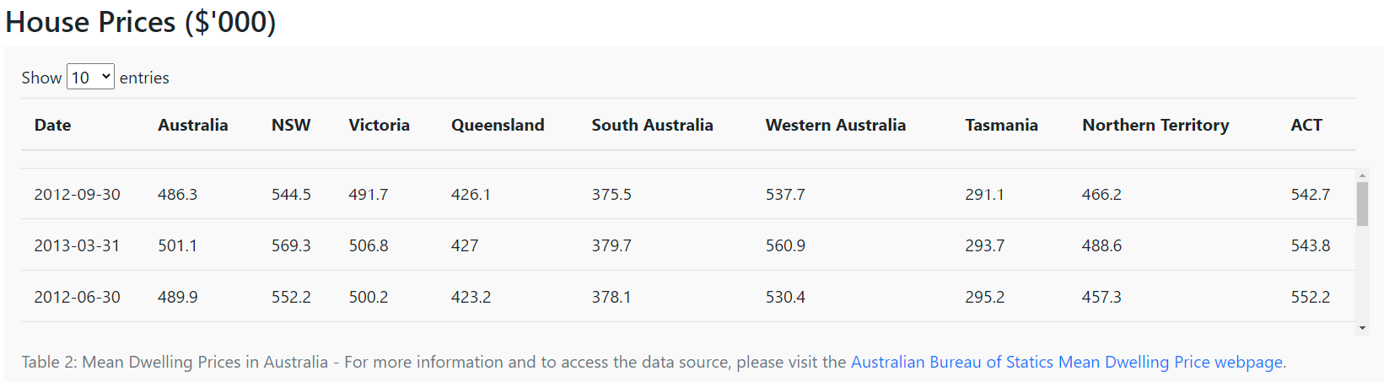
Data Tables
Cash Rate, Mortgage Rate & House Price Data Tables Jquery
Table captions point clearly to data sources
Notes:
jQuery DataTables is a plug-in for the jQuery JavaScript library.
Provides easy to use and interactive tables
.Showcases real-time data representation
Dynamic filtering and sorting of data
User-friendly interface with intuitive navigation
Can be easily graphical representation of data using Plotly.js

Slide 9
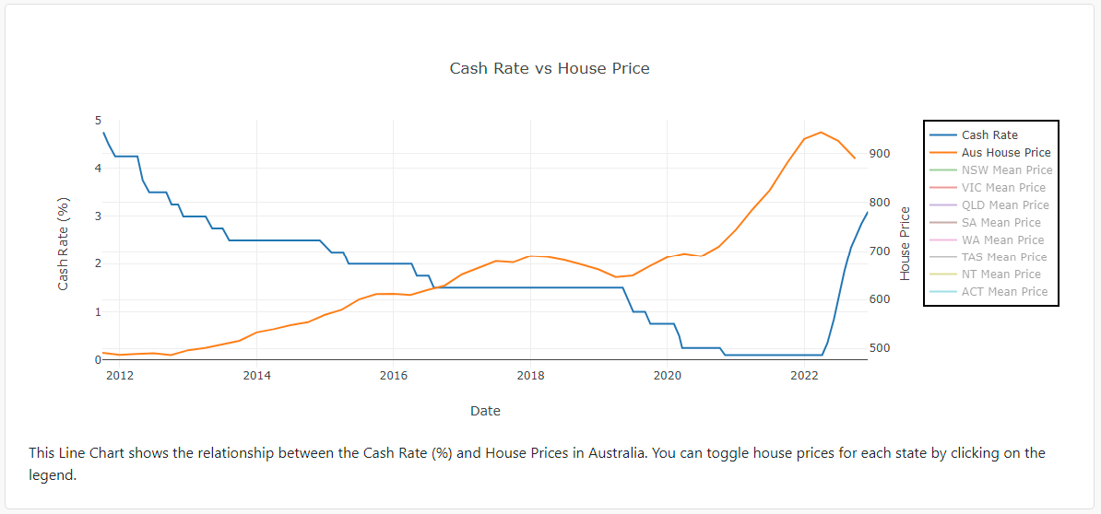
Visualisations
Plotly Line Chart
Notes:
Showcases relationship between interest rate changes and the Australian housing market through average house prices
Interactive and visually appealing representation of data
Allows for easy comparison of different states or Australia as a whole

Slide 10
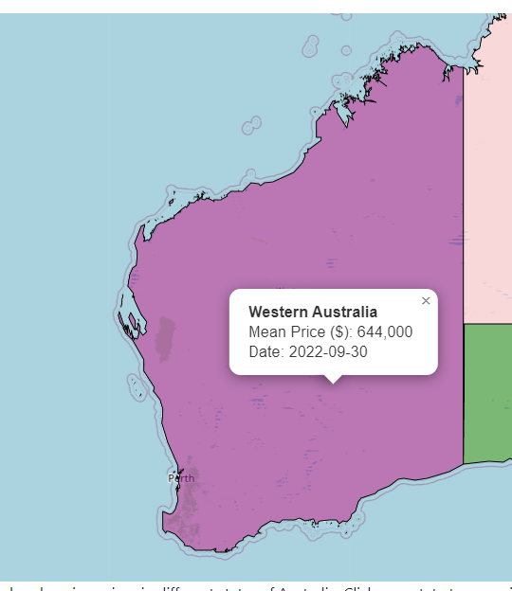
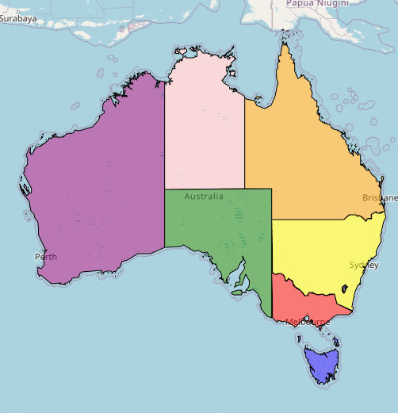
Visualisations
Leaflet Map
Notes:
This interactive map allows users to explore current housing prices in different states of Australia.
Users can click on a state to zoom in and see the latest mean house price in a pop-up. Use the chart to compare house prices among different states."

Slide 11
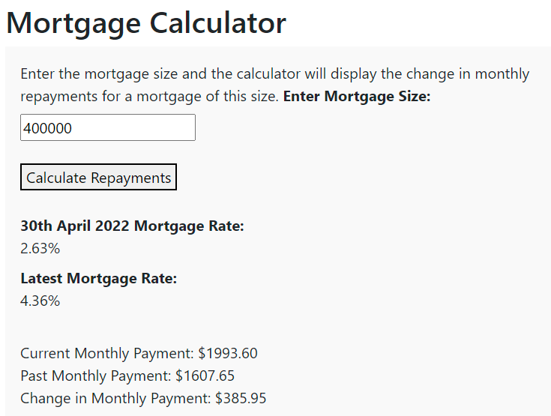
Visualisations
Interactive Mortgage Calculator
Notes:
The mortgage calculator is a tool within the InteractiveDataViz project that allows users to calculate the monthly mortgage payment based on the mortgage size.
The calculator provides a quick and simple way for users to understand the impact of different interast rates on monthly mortgage payments.

Slide 12
Limitations & Future Work
04

Slide 13
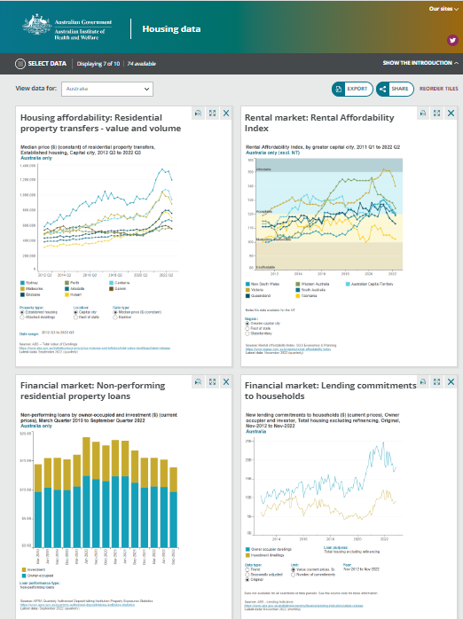
Limitations & Future Work
Data Coverage
Highlight areas for improvement
Potential future developments
New data sources and visualizations
Improved Data Storage
Notes:
- Highlight opportunities for future development and expansion of the project, such as incorporating additional data sources or expanding the scope of the analysis.
Improved layout css and html
More interactivity
Free Cloud Database / password limitation.

Slide 14
Q&A

